Slide 1
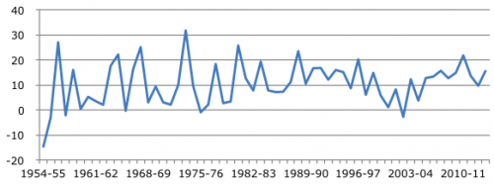
Agricultural Development in India
Agriculture is source of livelihood for more than 70% of Indians in the rural areas
It contributes around 18% to the total Gross Domestic Product of India
agriculture sector in India is also the largest employer contributing 49% of the total workforce.
Apart from employment, agriculture also plays an important role in food security.
growth rate of the agriculture in India mainly depends on the rainfall

Slide 2
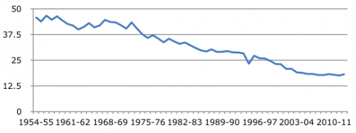
At the time of Independence agriculture contributed almost half of the total GDP which has declined to 18% in the recent years which was more than 45% in 1954-55

Slide 3
Rice production
Rice is one of the major food crops grown in India
Rice is considered as a diverse crop which can be grown in diverse climate and soil condition.
Total production of rice was around 20 million tons in 1950 which has increased to around 106 million tons in 2013 – 14.
Wheat Production
India is the second largest producer of wheat with total production of 88.94 million tons in 2014-15.
Growth of the agriculture production in India (including wheat) largely depend on monsoon
The highest growth rate was achieved in 1967-68 when the growth rate of wheat production was 45%.

Slide 4
Major problems faced by the agriculture sector in
India
Lack of irrigation facility and inefficient government policies has led to distress in the sector.
majority of the cultivated area is dependent on the yearly rainfall.
lack of agriculture marketing, inadequate storage facility

